Slide 1
One Day Workshop
on
Mental Health
Conducted By,
Dr. Ganesh Lokhande
(M.A. B.Ed. SET, Ph.D. CAPI)
Head, Department of Psychology
R. B. Narayanrao Borawake College, Shrirampur

Slide 2
Health……………..
Mental Health and Disorders……………
Techniques for Improving Mental Health……

Slide 3
What is Health?
Physical Well-being
Mental Well-being
Social Well-being
Absence of Disease
Health

Slide 4
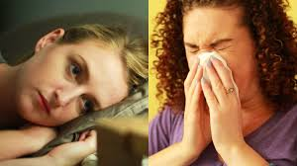

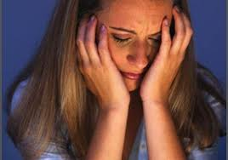
What is Physical Health ?
Effectively Functioning of Body
What is Social Health ?
Healthy Interactions : person and their Society
What is Mental Health ?
Meaningfully reactions to life
experiences

Slide 5
MENTAL HEALTH
Satisfaction,
Productivity,
Positive Attitude,
Emotional Stability
Adjustment.
Mental health

Slide 6
Mental Disorders
Behavior Deviation from Social Norms
APA Classification Mental Disorder: DSM
DSM: I : 1952
DSM:II:1968
DSM:III: 1980, R-1987
DSM:IV: 1994
DSM:V:2013
Criteria of Mental Disorders:
1. Mental Criteria
2. Social Criteria
3. Biological Criteria

Slide 7
Improving Mental Health
Aware Self- Abilities
Approve Self-Demerits
Self- Awareness / Identity
Develop Your Internal Locus of Control
Develop good interest and habits

Slide 8
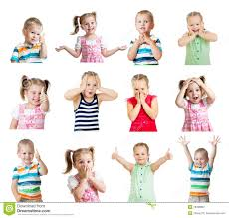

Improving Mental Health
Develop Emotional quotient
Control Emotions
Get new knowledge
Attention your work and duty
Create effectively life style
Increase rational thoughts

Slide 9


Improving Mental Health
Look positive day Dreams
Regular Mental Checkups
Healthy Communication
Get Social Support
Stress and Anxiety Management

Slide 10


Thank You

